Slide 1

Planning

Slide 2
Foundations of planning
What is planning?
A primary managerial activity that involves:
Defining the organizational goals
Establishing the overall strategy for achieving that goal
Developing plans for organizational work activities

Slide 3
Purposes of planning
Provides direction
Reduces uncertainty
Minimizes waste and redundancy
Sets the standard for controlling

Slide 4
Purposes of planning
1. Provides direction:
Planning helps set a clear direction for the organization by defining its goals, objectives, and strategies. It outlines the path that the organization should follow to achieve its desired outcomes.
For example:
A technology company plans to expand its market share by entering new geographic regions and launching innovative products over the next five years.
An educational institution plans to improve student performance by implementing new teaching methodologies and curriculum enhancements over the academic year.

Slide 5
Purposes of planning
2. Reduces uncertainty:
Planning allows organizations to anticipate potential challenges and opportunities, reducing uncertainty in an ever-changing business environment. By forecasting future trends and developments, organizations can prepare for various scenarios and make informed decisions.
For example:
A manufacturing company conducts market research and industry analysis to forecast demand for its products and plan production schedules accordingly.
A healthcare organization develops contingency plans to address potential disruptions in service delivery due to natural disasters or public health emergencies.

Slide 6
Purposes of planning
3. Minimizes waste and redundancy:
Through effective planning, organizations can optimize resource allocation and streamline processes, minimizing waste and redundancy. By identifying inefficiencies and eliminating unnecessary activities, organizations can improve productivity and cost-effectiveness.
For example:
A retail chain optimizes its supply chain operations by implementing just-in-time inventory management techniques, reducing excess inventory and storage costs.
A construction company develops a detailed project plan that sequences tasks and resources efficiently, minimizing idle time and costly rework.

Slide 7
Purposes of planning
4. Sets the standard for controlling:
Planning establishes benchmarks and performance standards against which actual results can be measured and evaluated. It provides a basis for monitoring progress, identifying deviations from the plan, and taking corrective actions as needed.
For example:
A software development firm sets milestones and deadlines for each phase of a project and tracks progress using project management software. Deviations from the schedule trigger adjustments in resource allocation or project scope to ensure timely delivery.
A financial institution compares actual financial performance against the budgeted targets on a quarterly basis and adjusts expenditure priorities or revenue-generation strategies accordingly.

Slide 8
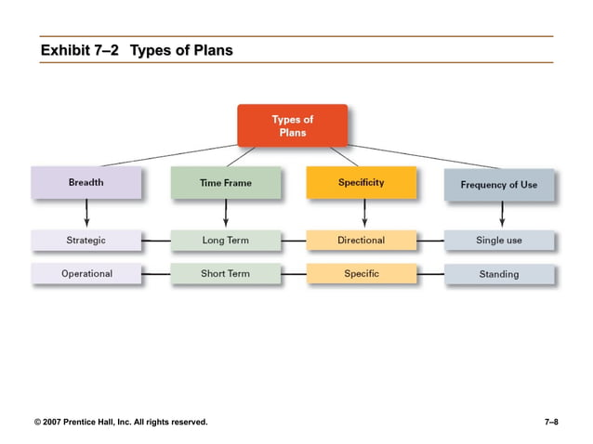

Slide 9
Types of Plans
Strategic Plan: A strategic plan outlines an organization's long-term goals and the actions necessary to achieve those goals. It typically covers a period of three to five years or even longer and provides a framework for decision-making and resource allocation. Strategic plans focus on the organization as a whole and its direction in the broader context of its environment.
Operational Plan: An operational plan details the specific activities and tasks required to implement the strategies outlined in the strategic plan. It typically covers a shorter time frame, often one year, and provides detailed guidance for day-to-day operations. Operational plans are more focused on the execution of tasks and the allocation of resources to meet short-term objectives.

Slide 10
3. Long-term plans:
Plans with time frame of three year or more.
4. Short term plans:
Plans with time frame of one year or less.

Slide 11
5. Specific plans
Specific plans provide detailed and precise guidance regarding the steps to be taken, the resources required, and the timeline for achieving a particular goal. These plans leave little room for interpretation and are highly detailed in nature.
6. Directional plans
Directional plans provide a broader framework or general guidance without specifying detailed actions or timelines. These plans offer flexibility and allow for interpretation and adaptation based on changing circumstances.

Slide 12
7. Single use plan:
Single-use plans are designed to address specific, one-time events or situations. These plans are developed for a particular task or objective and are typically not used again once the task is complete.
8. Standing plan:
Standing plans are designed to address recurring tasks or situations that occur frequently within an organization. These plans are established once and used repeatedly over time to guide ongoing operations.

Slide 13
Contingency Factors on Planning
Market Conditions:
Changes in market demand, economic conditions, and competitive landscape can impact the feasibility and success of a plan. For instance, a sudden shift in consumer preferences or an economic recession may necessitate adjustments to production or marketing plans.
Technological Advancements:
Rapid technological advancements can disrupt existing plans by making current processes obsolete or offering new opportunities. Planning must account for potential technological innovations or disruptions that could impact operations.
Regulatory Environment:
Changes in regulations, laws, or government policies can necessitate adjustments to business plans. Compliance requirements or new industry standards may require organizations to modify their strategies or operations.

Slide 14
4. Resource Availability:
Availability of resources such as finances, manpower, raw materials, and equipment can impact planning. Unexpected shortages or surpluses in resources may require adjustments to the planned activities or timelines.
5. Environmental Factors:
Natural disasters, weather conditions, and other environmental factors can disrupt operations and affect planning. Contingency plans for emergencies such as hurricanes, earthquakes, or pandemics are essential to ensure business continuity.
6. Stakeholder Expectations:
Changes in stakeholder expectations, including customers, employees, investors, and communities, can influence planning decisions. Effective communication and stakeholder management are critical to align plans with stakeholders' needs and preferences.

Slide 15
7. Global Events:
Geopolitical events, trade disputes, or global health crises can have far-reaching impacts on planning. Organizations must consider the geopolitical landscape and global events that could affect their operations or supply chains.
8. Organizational Culture:
Organizational culture and values can influence planning processes and decision-making. Resistance to change or lack of alignment with organizational values may pose challenges in implementing plans effectively.
9. Competitive Dynamics:
Actions taken by competitors, such as new product launches or pricing strategies, can affect the success of planned initiatives. Planning should account for competitive dynamics and potential responses from competitors.

Slide 16
Planning Process
Analyze opportunities
Implementation of plan
Reviewing the planning process
Formulation of derivative plans
Selecting best course of action
Evaluation of alternatives
Setting goals
Determination of alternatives
Determination of premises

Slide 17
Process of Planning
1. Analyze opportunities
This is the pre step of planning and essential to make a successful plan.
In this step SWOT analysis is done from the environment.
Strength and weaknesses are from internal environment and threats and opportunities are from external environment.
2. Setting goals
This is the first and actual starting point of planning.
Goals must be specific, clear and practical.
Goals must be set by considering the organizational resources and opportunities.

Slide 18
3. Determination of premises
Premises are the assumptions of the future based on which plan is formulated.
Premises may be internal or external and tangible or intangible.
Examples are capital investment, cost per unit, goodwill, motivation etc.
4. Determination of alternatives
Managers must determine various courses of action for the achievement of objectives.
To get the best course of action, different alternatives are identified.
The management must develop the alternatives through the support of experienced and intellectual experts.

Slide 19
5. Evaluation of alternatives
This is a logical step to evaluate each alternative from cost and benefit point of view.
Management must apply broad based analytical approach for such evaluation.
Alternatives are studied in terms of factors like risk, resources, technology etc.
6. Selecting best course of action
After evaluating, manager must select one best course of action.
For this manager must consider experience, present situation and future contingencies.

Slide 20
7. Formulation of derivative plans
Derivative plans are formulated to help the better implementation of basic plan.
Derivative plans are formulated for each department of organization.
8. Implementation of plan
This step brings all the paper work in action.
For proper implementation, manager takes certain steps like communication with employees, provide guidance, arrangement of resources etc.
9. Reviewing the planning process
Managers take this step to evaluate the actual performance and find out if there are any deviations.
It helps to take corrective measures on time.
It also helps to adapt with the environment.

Slide 21
Objectives: The foundation of planning
Objectives are specific, measurable, achievable, relevant, and time-bound (SMART) statements that articulate the desired outcomes or results that an individual, team, or organization aims to achieve within a defined period.
They serve as the foundation for planning, guiding activities and decisions towards the accomplishment of overarching goals.
Examples of objectives may include increasing revenue by a certain percentage, improving customer satisfaction scores, reducing costs, expanding market share, enhancing employee productivity, or launching a new product within a specified timeframe.

Slide 22
Multiplicity of objectives
The multiplicity of objectives refers to the existence of multiple goals or desired outcomes that an individual, organization, or project pursues simultaneously.
In many real-world situations, it's common for there to be various objectives that stakeholders aim to achieve, often reflecting diverse interests, priorities, and perspectives.
Key aspects:
Diverse Stakeholder Needs: Different stakeholders may have distinct objectives based on their roles, responsibilities, and interests. For example, shareholders may prioritize financial objectives such as profitability and return on investment, while employees may focus on objectives related to job satisfaction and career development.
Complexity of Goals: In complex environments, achieving success may require addressing multiple dimensions simultaneously. For instance, a business may aim to increase revenue while also enhancing customer satisfaction, improving operational efficiency, and fostering innovation.
Dynamic Environment: Objectives may evolve over time in response to changes in the internal or external environment. As market conditions, technologies, and stakeholder preferences change, organizations may need to adjust their objectives to remain relevant and competitive.

Slide 23
Real versus stated objectives
Real objectives are the objectives that an organization actually pursues, as defined by the actions of its members. Real objectives often drive behavior and decision-making more significantly than stated objectives.
Stated objectives are the official statements of what an organization says- and what it wants its various stakeholders to believe- its goals are. These objectives are explicitly articulated or communicated.
For example, a number of universities say that their goal is limiting class sizes, facilitating close student-faculty relationships, and actively involving students in the learning process, but they commonly hold 300+ student lecture classes.

Slide 24
Traditional objective setting
In traditional goal setting, goals set by top managers flow down through the organization and become subgoals for each organizational area.
This traditional perspective assumes that top managers know what’s best because they see the “big picture”.
And the goals passed down to each succeeding level guide individual employees as they work to achieve those assigned goals.
Turning broad strategic goals into departmental, team, and individual goals can be difficult and frustrating process.
The problem that may arise is that managers at each level define the goals and apply their own interpretations and biases as they make them more specific.

Slide 25
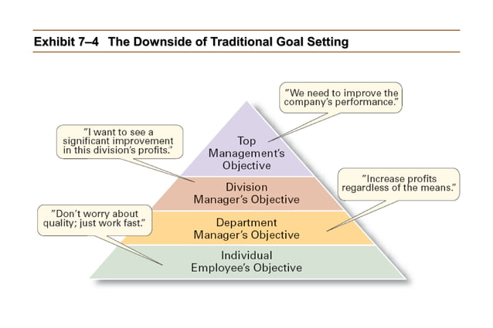

Slide 26
Management by Objectives(MBO)
Developed by Peter F Drucker
MBO is the process of setting mutually agreed upon goals and using these goals to evaluate employee performance.
Firstly define organizational objectives
Then the specific performance goals are jointly determined by employees and the managers.
Progress towards accomplishing goals is periodically reviewed.
Rewards are allocated on the basis of progress towards the goals.
Regular feedback is provided to employees regarding their performance relative to the established objectives. This feedback serves as a basis for evaluating performance, identifying areas for improvement, and recognizing achievements.

Slide 27
Advantages and disadvantages of MBO
Advantages
Clarity of Goals: MBO promotes clarity in organizational objectives, ensuring that everyone understands what needs to be accomplished and how their individual goals contribute to the overall mission.
Alignment with Organizational Objectives: By linking individual and team objectives with organizational goals, MBO ensures that efforts are focused on strategic priorities.
Increased Employee Engagement: Involving employees in the goal-setting process fosters a sense of ownership and commitment, leading to higher levels of motivation and engagement.
Enhanced Performance Management: MBO provides a structured framework for measuring and monitoring performance, enabling timely feedback and recognition of achievements.

Slide 28
Advantages and disadvantages of MBO
Disadvantages:
Overemphasis on Goal Achievement: In some cases, employees may prioritize achieving their objectives at the expense of other important aspects of their work, such as collaboration or creativity.
Complexity and Time-Consuming: Implementing MBO requires significant time and effort, including setting goals, monitoring progress, and providing feedback. This can be challenging for organizations with limited resources or competing priorities.
Potential for Conflict: Differences in priorities or objectives between individuals or departments may lead to conflicts or competition within the organization.
Decrease employee confidence if the goals are too hard to complete.

